Slide 2
Unit 4: Discrete System (7 hrs)
4.1 Introduction To Discrete System
4.2 Components Of The Discrete System
4.3 Representation Of Time
4.4 Examples For Discrete Systems
4.4.1 Telephone Call System As Lost Call And Delayed Call System
4.4.2 Bank Queue System
4.5 Simulation Programming Task
4.6 Steps Of Simulation Programming Task
4.7 Gathering Statistics
4.7.1 Counters And Summary Measures
4.7.2 Measuring Utilization And Occupancy
4.7.3 Recording Distribution And Transit Time
4.8 Discrete System Simulation Languages

Slide 3
Gathering Statistics
To print out the statistics gathered during the run, the simulation programming system includes a report generator.
The exact statistics a model requires depend on the study being performed.
Some of the commonly required statistics which is usually included in the output during the simulation are as follows:

Slide 4
Gathering Statistics
Counts: This gives the number of entities of a particular type or the number of times some events occur.
Summary measures: This includes measuring some quantities such as extreme values, mean values, and standard deviation.
Utilization: This measure is the time in fraction or percentage that some entity is engaged.
Occupancy: These give the percentage of a group of entities in use on average.

Slide 5
Gathering Statistics
Distribution: These records the distribution of important variables such as queue length or waiting time.
Transit time: This records the time taken from an entity to move from one part of the system to some other part.
When stochastic effects are operating in the system, all these measures will fluctuate as a simulation proceeds and the particular values reached at the simulation are taken as estimates of the true values they are designed to measure.

Slide 6
Counters And Summary Measures
Counters are used to accumulate totals and to record current values of some level in the system.
For example, in the simulation of the telephone system, counters are used to record the total number of lost calls, busy calls, and to keep track of how many links were in use at any time.
Whenever a new value of a count is established, it is compared with the record of the current maximum or minimum, and the record is changed when necessary.

Slide 7
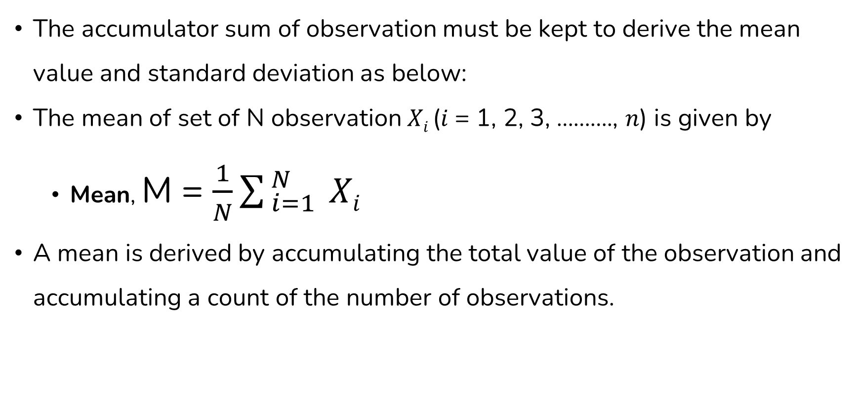
Counters And Summary Measures
The accumulator sum of observation must be kept to derive the mean value and standard deviation as below:
The mean of set of N observation 𝑋_{𝑖} (𝑖 = 1, 2, 3, ………., 𝑛) is given by
Mean, M = $\frac{1}{N}\sum_{ i=1}^{ N}{ Xi}$
A mean is derived by accumulating the total value of the observation and accumulating a count of the number of observations.

Slide 8
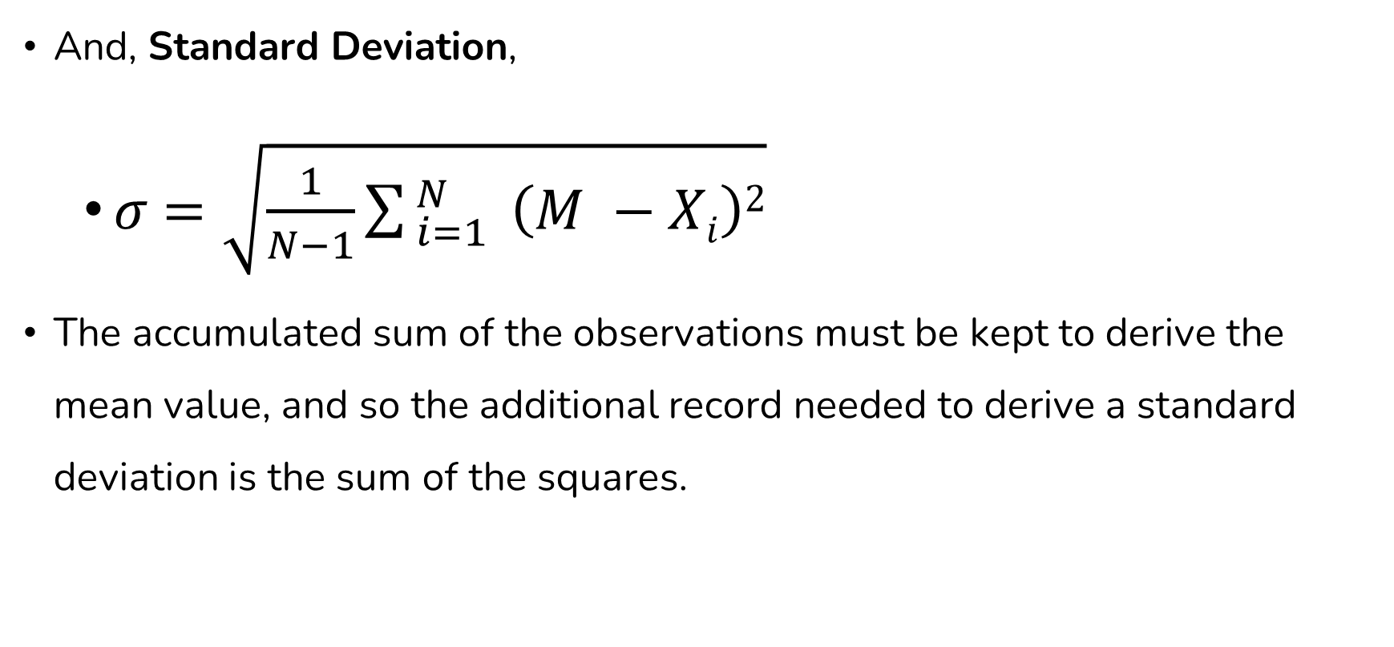
Counters And Summary Measures
And, Standard Deviation,
𝜎 $=\sqrt{\frac{1}{N−1}\sum_{ i=1}^{ N}{ \left(M −Xi\right)2}}$
The accumulated sum of the observations must be kept to derive the mean value, and so the additional record needed to derive a standard deviation is the sum of the squares.

Slide 9
Measuring Utilization And Occupancy
The common requirement of simulation is measuring the load on some entity, such as an item of equipment.
To measure the load on some entity, the simplest way is to determine what fraction/percentage of time the item has engaged during the simulation.
Measuring those statistics is referred to as the utilization of that equipment.

Slide 10
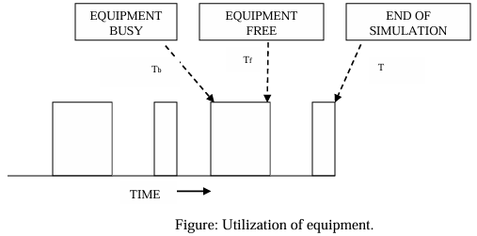
Measuring Utilization And Occupancy
The time history of an equipment usage might appear as shown in figure below:

Slide 11
Measuring Utilization And Occupancy
Let,
T_{b} = the time at which the item last became busy.
T_{f} = the time at which the item last became free.
T = total time in simulation run.
To measure utilization, it is necessary to keep a record of the time T_{b} at which the last item becomes busy.
When the item becomes free at T_{f}, the interval (T_{f}-T_{b}) is derived and added to the counter.

Slide 12
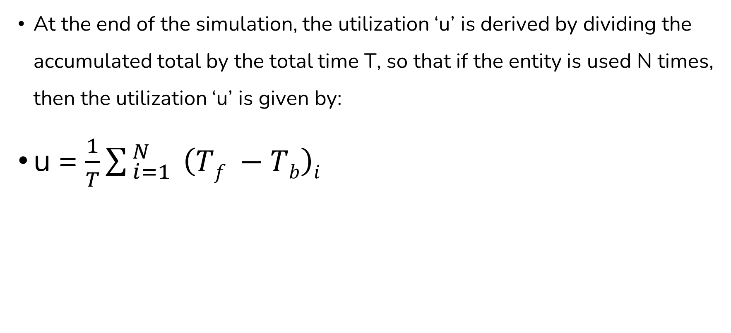
Measuring Utilization And Occupancy
At the end of the simulation, the utilization ‘u’ is derived by dividing the accumulated total by the total time T, so that if the entity is used N times, then the utilization ‘u’ is given by:
u = $\frac{1}{T}\sum_{ i=1}^{ N}{ \left(Tf −Tb\right)i}$

Slide 13
Measuring Utilization And Occupancy
In dealing with a group of entities, rather than individual items, the calculation is similar, requiring that information about the number of entities involved also be kept.
The below figure represents as a function of time and the number of links in telephone system that are busy.
To find an average number of links in use, a record must be kept of the number of links currently in use and the time at which the last change occurred.
If the number changes at time T_{i} to the value n_{i}, then, at the time of the next change T_{i+1}, the quantity n_{i} (T_{i+1} - T_{i}) must be calculated and added to an accumulated total.

Slide 14

Measuring Utilization And Occupancy
The average number in use during the simulation run, A, is then calculated at the end of the run by dividing the total by the total simulation time T, so that:
A = $\frac{1}{T}ni (Ti+1−Ti)$

Slide 15
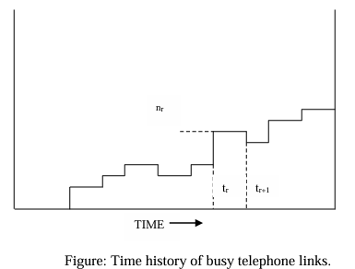
Measuring Utilization And Occupancy
The below figure might also represent number of entities waiting on a queues.

Slide 16
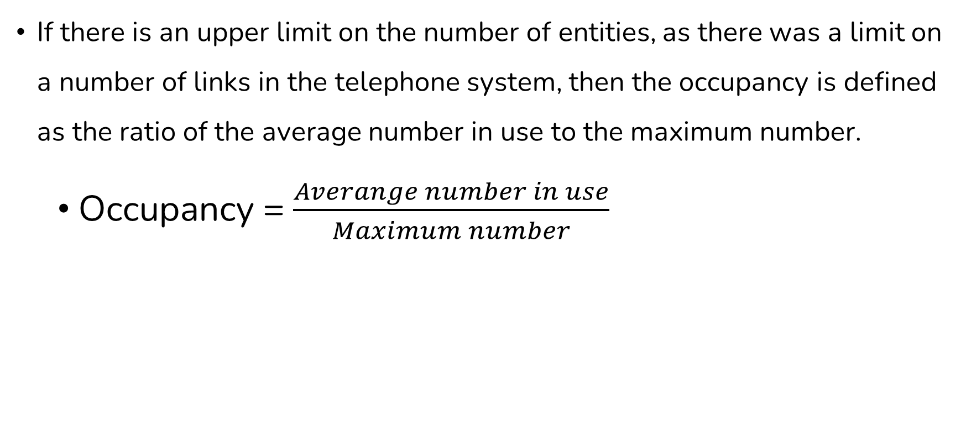
Measuring Utilization And Occupancy
If there is an upper limit on the number of entities, as there was a limit on a number of links in the telephone system, then the occupancy is defined as the ratio of the average number in use to the maximum number.
Occupancy = $\frac{Averange number in use}{Maximum number}$

Slide 17
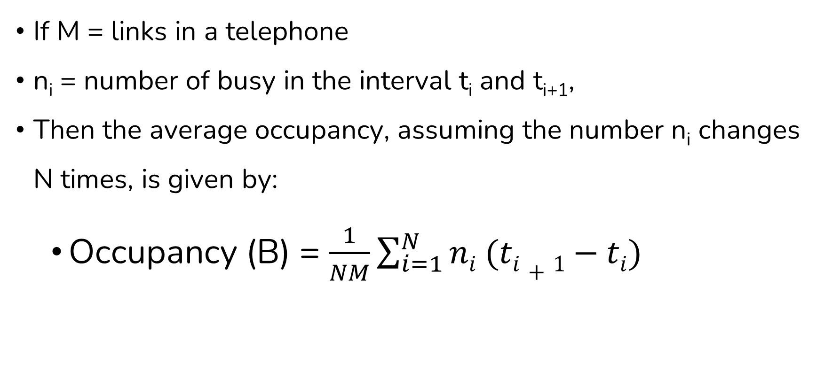
Measuring Utilization And Occupancy
If M = links in a telephone
n_{i} = number of busy in the interval t_{i} and t_{i+1},
Then the average occupancy, assuming the number n_{i} changes N times, is given by:
Occupancy (B) = $\frac{1}{NM}\sum_{i=1}^{N}{ni (ti+1−ti)}$

Slide 18
Measuring Utilization And Occupancy
So, the basic difference between utilization and occupancy is that timing information must be kept for each individual entity for utilization.
While, in the case of occupancy, only require keeping count of a class of entities and recording the last time the count was changed.
Another is that, if the number of active entities is large, it can cost more space and time to record utilization than occupancy.

Slide 19
Recording Distribution And Transit Time
To determine the distribution of a variable it requires counting how many times the value of the variable fall within specific interval.
For this purpose, a table with location to define the interval and to accumulate the count has to be maintained.
When an observation is made, the value is compared with the defined intervals and the appropriate must be incremented by one.

Slide 20
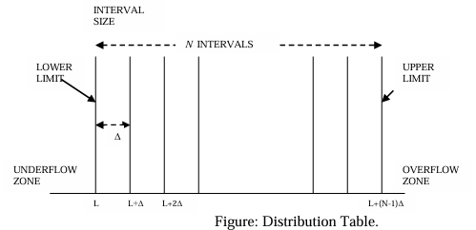
Recording Distribution And Transit Time
The definition of a distribution table requires specification for lower limit of the tabulation, the interval size and the number of intervals.
Normally, the tabulation interval sizes are uniform.

Slide 21
Recording Distribution And Transit Time
Generally, it is necessary to count how many times an observation falls below the lower limit and beyond the upper limit.
It is also necessary to accumulate the number of observations and the sum of the squares, to calculate the mean value and the standard deviation, at the same time the distribution is being derived.
To determine the mean and standard deviation, it will be required to accumulate the number of observations (𝑋_{𝑖}) and the sum of squares ∑(𝑋_{𝑖})².

Slide 22
Recording Distribution And Transit Time
For each observation 𝑋𝑖,
One is added to the appropriate counter
𝑋_{𝑖} is added to the sum, ∑(𝑋_{𝑖})
(𝑋_{𝑖})² is added to the sum, ∑(𝑋_{𝑖})².

Slide 23
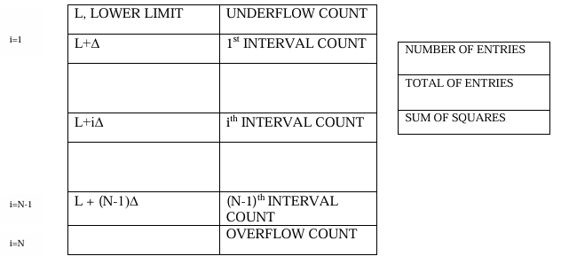
Recording Distribution And Transit Time
The space required for the tabulation shown in figure below:

Slide 24
Recording Distribution And Transit Time
Since values of observation are matched to an interval, the derived distribution is an approximation.
However, note that the mean and standard deviation will be accurate within the accuracy limit of the computer, even if some observations fall outside the table limits.
The instances when the observations are made are determined by the native of the random variable being measured.

Slide 25
Recording Distribution And Transit Time
To understand this, consider the following two examples:
To measure the mean waiting time for a service, an observation must be taken as each entity starts to receive a service, so that the times at which the observations are tabulated are randomly spaced.
To measure the distribution of the number of entities waiting, observations should be taken at a uniform time interval.
The final output weight also expresses the data in other commercial forms as required.

Slide 26
Recording Distribution And Transit Time
For example, cumulative distribution may be given or the distribution may be resolved to express the counts as percentage of total observation.
These all results are calculated at the end of simulation.

Slide 27
Recording Distribution And Transit Time
A clock is used in the manner of time stamp to measure transit time.
When an entity reaches a point from which a measurement of transit time is to start, a note of the time of arrival is made.
Later, when the entity reaches the point at which the measure ends, a note of the clock time upon arrival is made, and these two clock time noted are used to compute the elapsed time.

Slide 28
Discrete System Simulation Languages
To simplify the task of writing a discrete simulation program, several programming languages are used.
The two most commonly used are:
GPSS
SIMSCRIPT

Slide 29
Discrete System Simulation Languages
These languages are used to describe a system and establish a system image and execute a simulation algorithm.
Most programming languages also provide report generators.
These languages also offer many convenient facilities such as,
Automatic generators of streams of pseudo-random numbers for any desired statistical destination.
Automatic data collection
Their statistical analysis and report generation
Automatic handling of queues, etc.

Slide 30
Discrete System Simulation Languages
Also, a good simulation provides a nodded builder with the view of the world that next nodded building easier.
Every discrete system simulation language must provide the concept and statement for:
Representing the state of a system at a single point in time (static modelling)
Moving a system from state to state (Dynamic modelling)
Performing relevant tasks such as the random number generation, data analysis, and report generation.

Slide 31
Discrete System Simulation Languages
Discrete system simulation languages can be classified into three main categories:
Event oriented languages
Activity-oriented languages
Process-oriented languages.

Slide 32
End of Lecture 13

Slide 33
Random Number Generation

